Slide 1
Personalized Fashion Recommendation - Ecommerce

Slide 2

Sakthivel Muthu 8.5 years of IT industry experience Passionate about Data science and deep learning

Slide 3
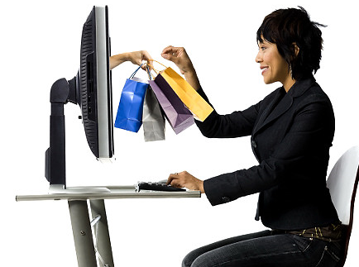
What is Recommendation System?

Slide 4
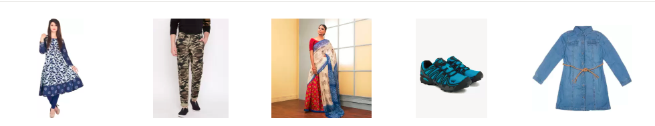
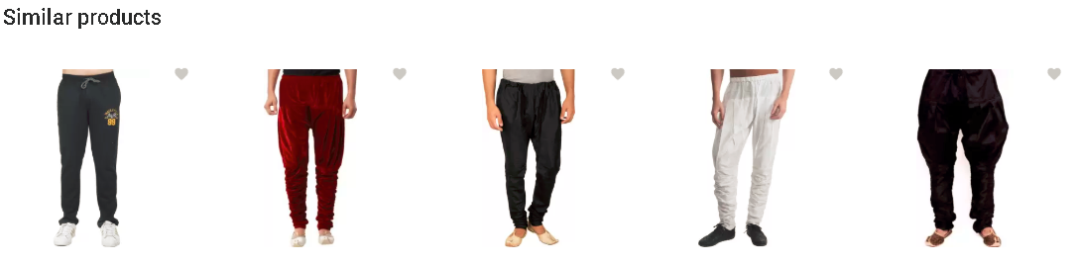

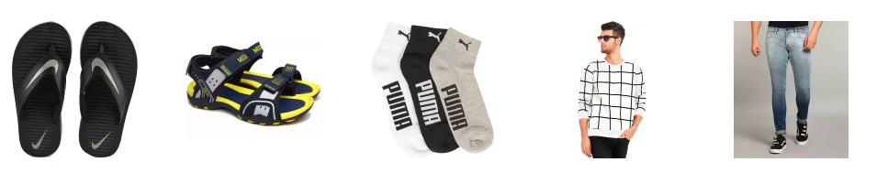
Popular Recommendation
Behavior Based Products Recommendation
Similar Products Recommendation
Popular / Trending Products Recommendation

Slide 5
Behavior Based Recommendation

Slide 6
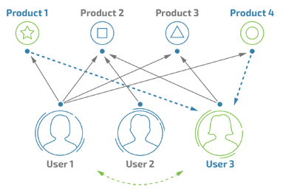
Collaborative Filtering

Slide 7
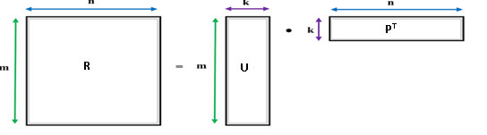
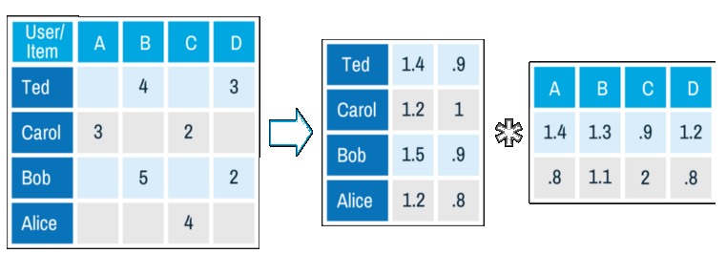
Matrix Factorization

Slide 8
Similar Products Recommendation

Slide 9
Visually Similar Products Recommendation
Identifying Visual Preference of the user
Find list of products satisfies step(1)
Recommend the product to user
How do we achieve it?
CNN – Convolutional Neural Network
K Nearest Neighbor

Slide 10
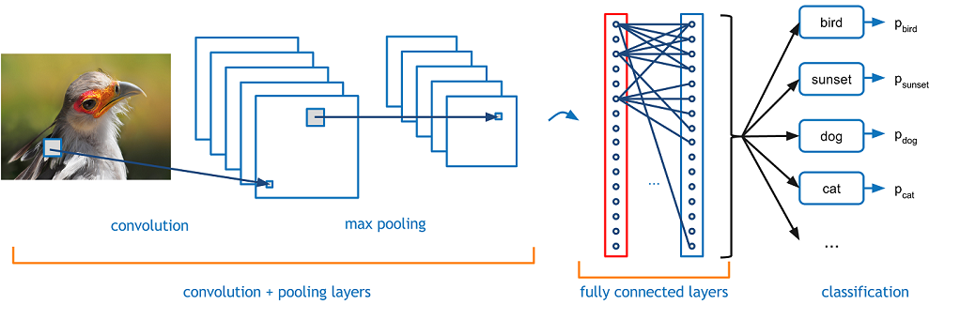
Convolutional Neural Network
Scan the Image → Understand about Scanned Image → Classify the image

Slide 11
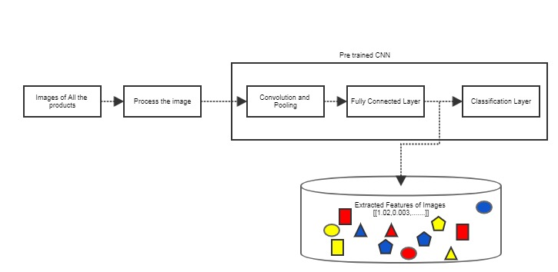
Feature Extraction - Offline

Slide 12
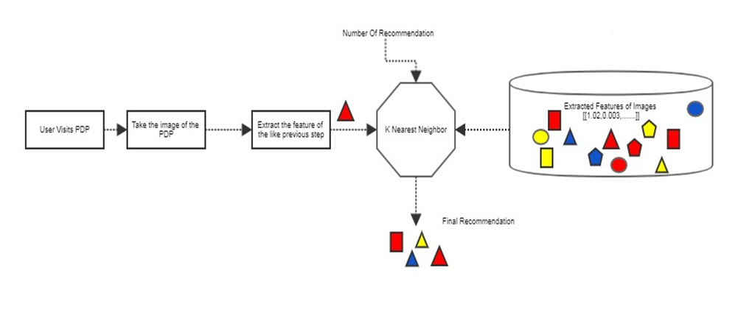
Similar Products Identification

Slide 13
Sample Journey

Slide 14
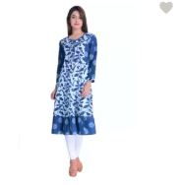
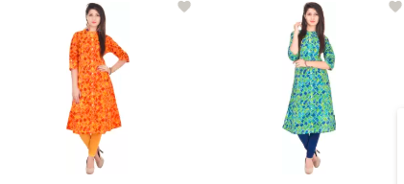
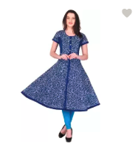
User Journey
User Login to Fashion Ecommerce site
Behavior Based Recommendation on Home page
User Clicks Product from Recommendation Page
On PDP user gets similar product Recommendation

Slide 15
Extended Features

Slide 16
Extended Features
Visually similar product recommendation Can be extended further. For example user can take an image of the competitor product and search in ecommerce site. This way it could be further extended for image based search
By including User profile data and Product metadata with collaborative filtering recommendation can be personalized further

Slide 17
Q&A

Slide 18
Thanks

